Slide 1
Low Impact Hydroelectric
What is it and can it help us achieve a carbon free energy future?
Gareth Hougham
Manna Jo Greene
Hudson River Sloop Clearwater

Slide 2
Outline
  Fossil fuels and the need for carbon free alternatives
  Hydroelectricity
    How does it work
    Conventional hydropower
      Environmental Impacts –
      Effect of dams on the life cycle of anadromous fish
    Low impact hydropower - An oxymoron or are there specific conditions and new
                technologies where this can be real and truly valuable?

Slide 3
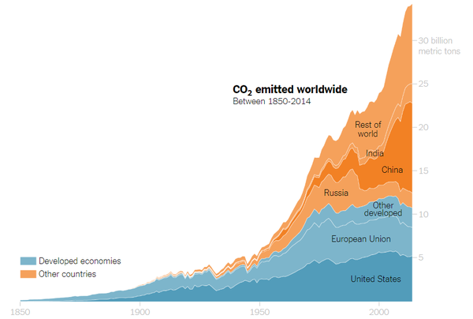
Fossil fuels release CO2 greenhouse gas
1850
1900
1950
2000

Slide 4
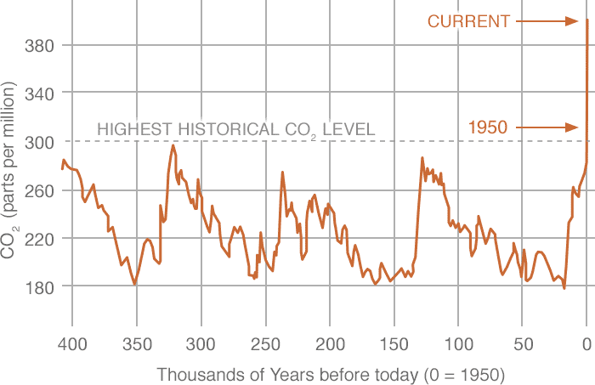
Historical CO2 Levels

Slide 5
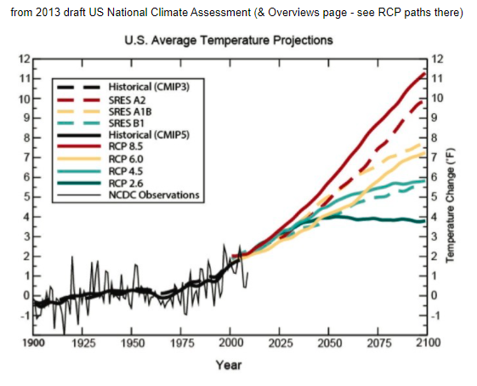
Global Average Temperature Change Predictions

Slide 6
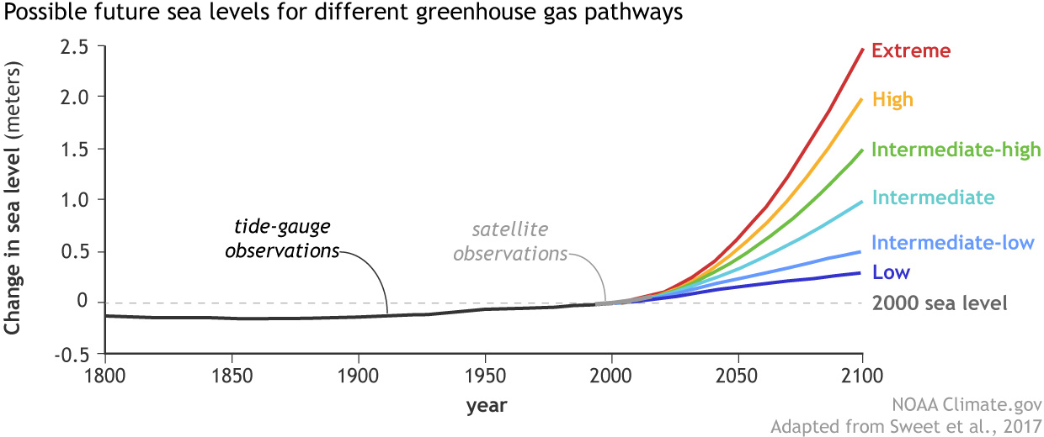

Slide 7
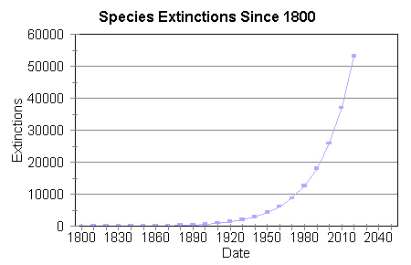

Slide 8
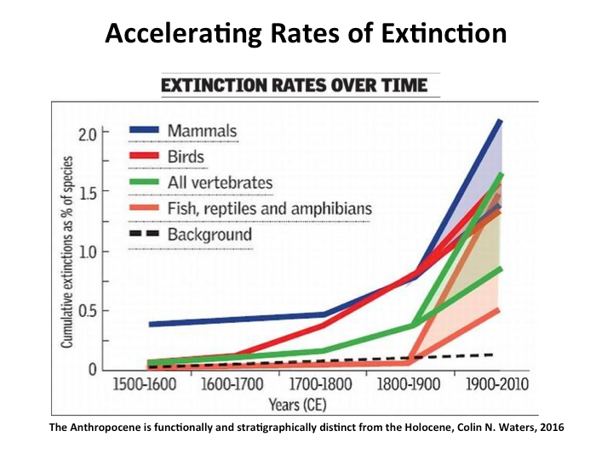

Slide 9
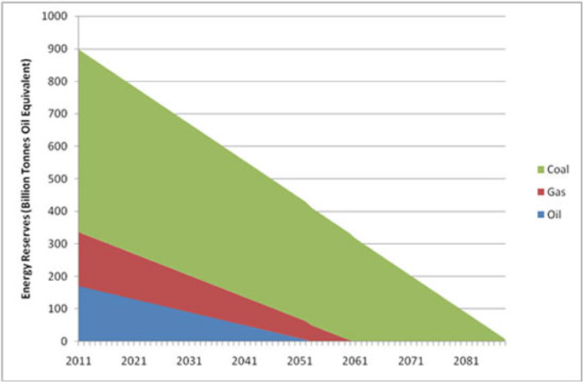
Fossil Fuel reserves
Even if we don’t reduce rate of consumption, will run out of fossil fuels soon anyway and need renewable energy

Slide 10
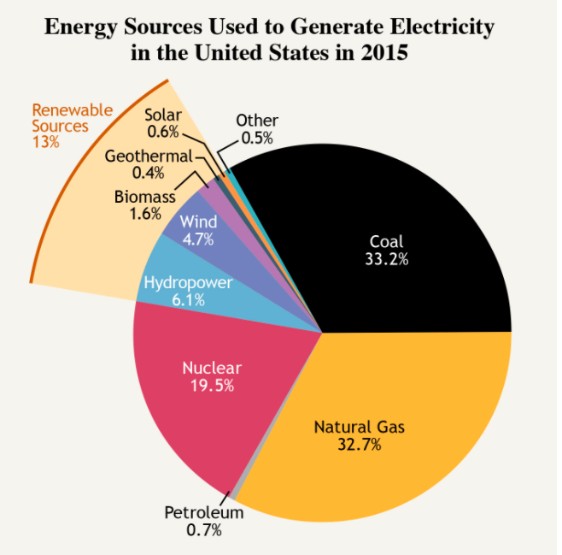
Source: National Academies of
Science, Engineering and Medicine

Slide 11
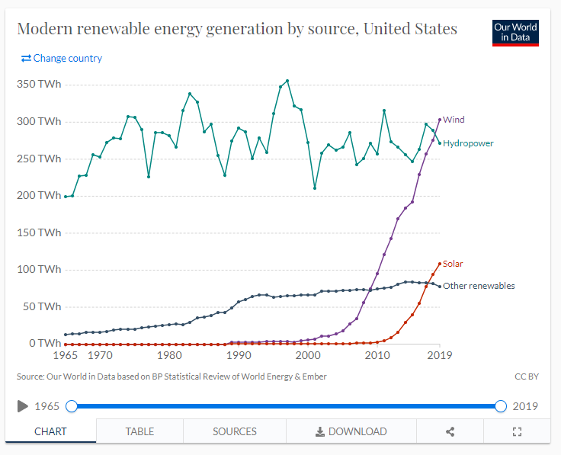
Renewable Energy in the United States

Slide 12
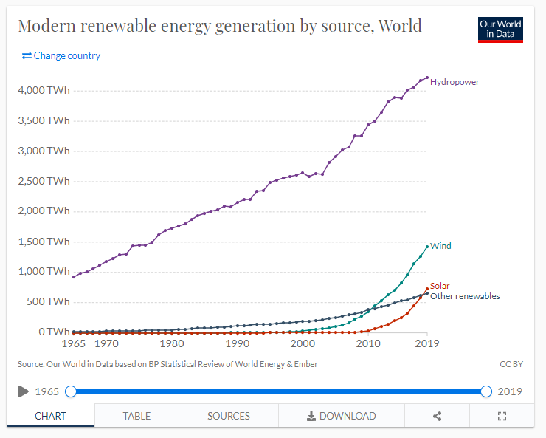
Renewable Energy across the World

Slide 13
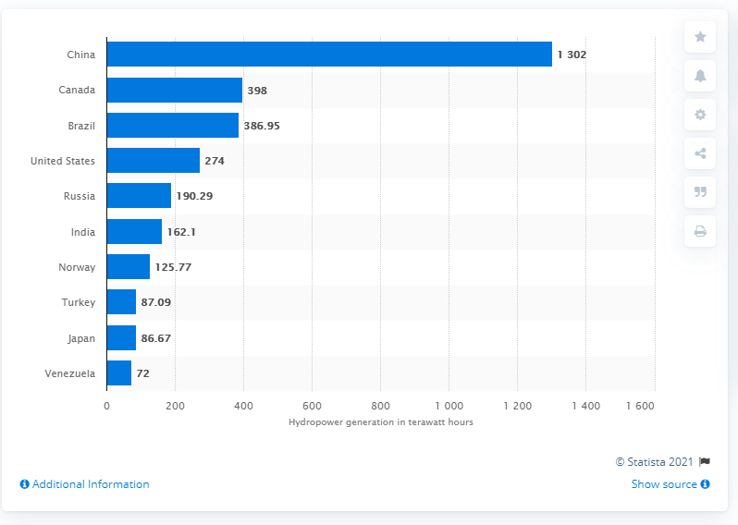
Hydropower Generation by country

Slide 14
Renewable Energy
Primary Technologies:
Solar
Wind
Hydroelectric
Biomass combustion

Slide 15
Renewable Energy
Primary Technologies:
Solar
Wind
Hydroelectric
Biomass combustion
The challenge with solar and wind energy is 24/7 reliability.
Low Impact Hydroelectric can help fill in the energy gaps.

Slide 16
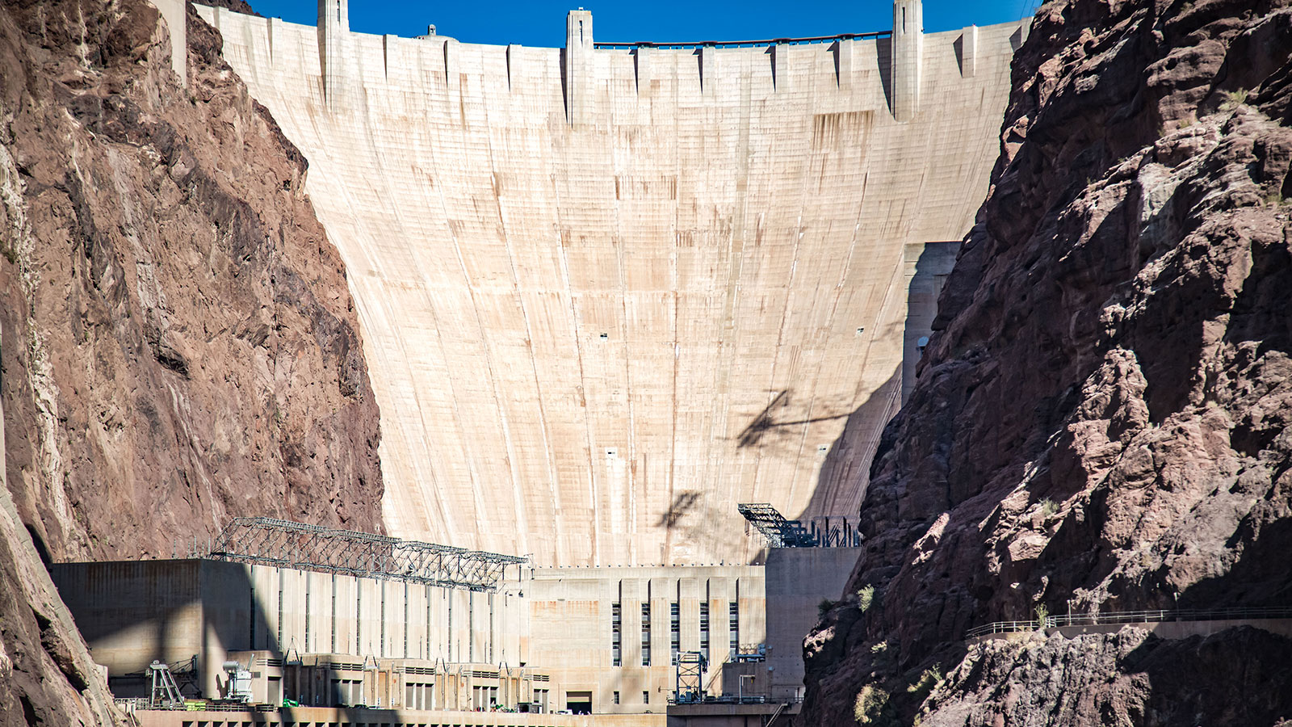
Hydroelectric Power Generation
Hoover Dam – on the Colorado River

Slide 17
Hydroelectric Power Generation
Example Power Plants:
  Hoover Dam - 2 GW
  3 Gorges Dam (China) – 22 GW
  Niagara Falls - 4.9 GW (Started generating in 1881 !)
90,000 dams in the USA.
There are about 2,500 hydroelectric plants in USA
There are 83,000 small hydroelectric plants worldwide

Slide 18
Hydroelectric Power Generation
Example Power Plants:
  Hoover Dam - 2 GW
  3 Gorges Dam (China) – 22 GW
  Niagara Falls - 4.9 GW (Started generating in 1881 !)
90,000 dams in the USA.
There are about 2,500 hydroelectric plants in USA
There are 83,000 small hydroelectric plants worldwide
For a rough comparison: Indian Point 3 produces 1 GW (gigawatts)
A typical household during the day might draw 10 KW (Kilowatts)
With these assumptions, 1 GW power plant could power 100,000 houses.

Slide 19
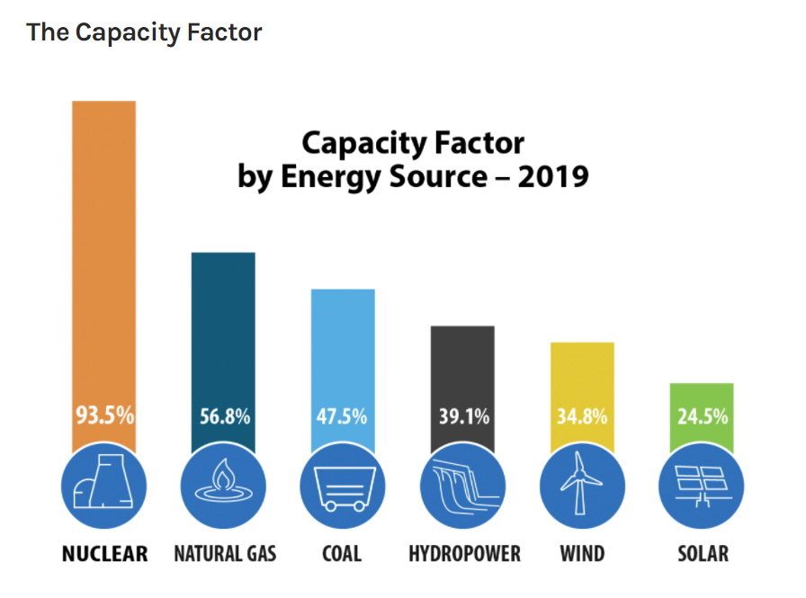
Hydroelectric Power Generation
A more accurate way to calculate generation output is annual generation
in terms of Gigawatt-hours.
Both the output of any power generating station AND the consumption of
that power by homes and industry are time-dependent.
For generation output, it is useful to think in terms of “Capacity Factor” (CF).
CF is calculated as the fraction of the listed output for a plant (“nameplate capacity”) that it actually produces electricity. This accounts for maintenance downtimes,
windless days for wind power, time of day and cloudiness for solar, etc.

Slide 20
Hydroelectric Power Generation
So a useful comparison between a typical nuclear and hydro plant generating 1 GW
and with typical annual household power needs:
 | Indian Point 3 | Hydro
GW (Gigawatt) | 1 | 1
Capacity Factor | 95% | 60%
GWh (Gigawatt Hours) | 8322 | 5256
Typical Household (kWh) | 10,000 | 10,000
Number of Homes | 832,200 | 525,600

Slide 21
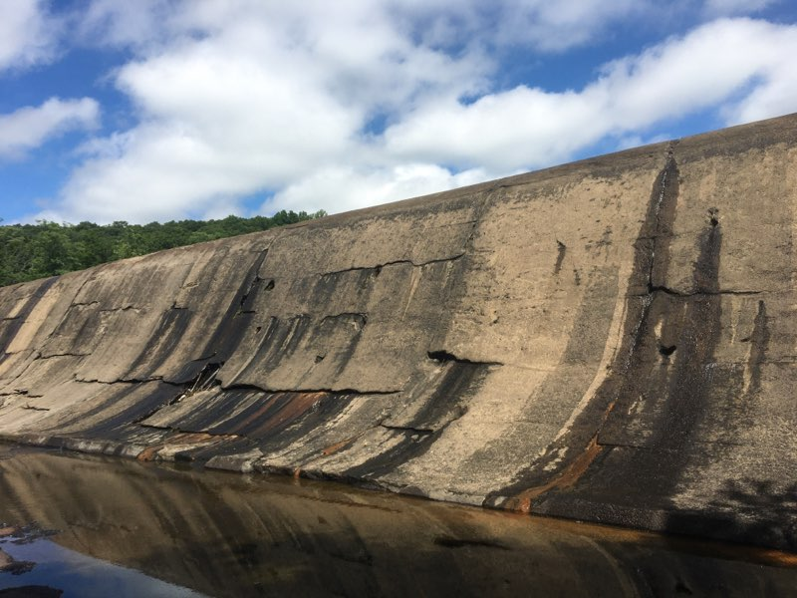
Kinnytown Dam – A small, high impact, hydroelectric dam
Generates only
2.3 megawatts.
Blocks 32 miles of river habitat for spawning anadromous fish including shad, salmon, and alewife
Seymour, Connecticut
Naugatuck River

Slide 22
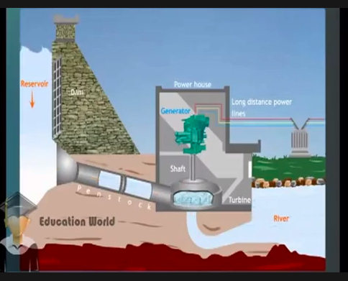

Slide 23
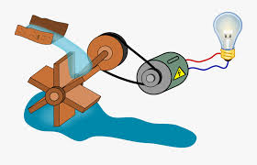
Hydropower:

Slide 24
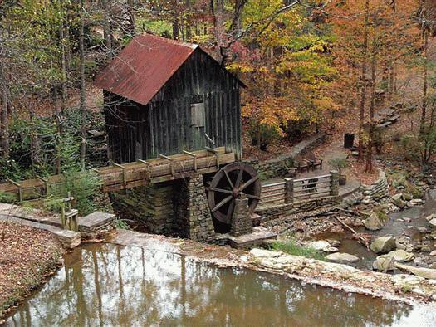
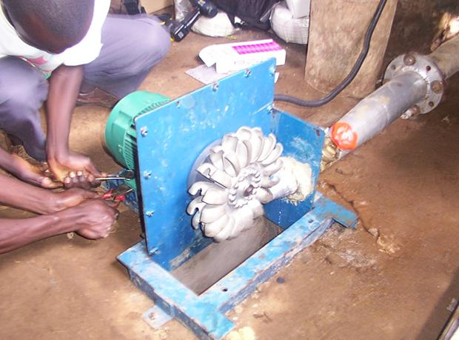
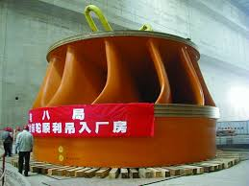
Turbine Definition: A turbine is a rotary mechanical device that
extracts energy from a fluid flow and converts it into useful work.
Hydroelectric turbine
from Three Gorges, China
Hydro mechanical turbine
Micro Hydroelectric turbine

Slide 25
The Problem with Dams
(not an exhaustive list, just examples)
Dams block the annual migration of anadromous fish
Fish populations decline
Ripple effect throughout ocean fishery
Water temperatures increase
Algae flourish creating HABs (hazardous algal blooms) which are highly toxic.
River ecology suffers downstream
Benefits of Dams:
  Water for drinking, irrigation
  Power

Slide 26
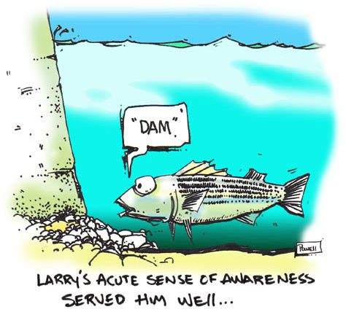
The Problem with Dams
Dams block the annual migration of anadromous fish
Fish populations decline
Ripple effect throughout ocean fishery

Slide 28
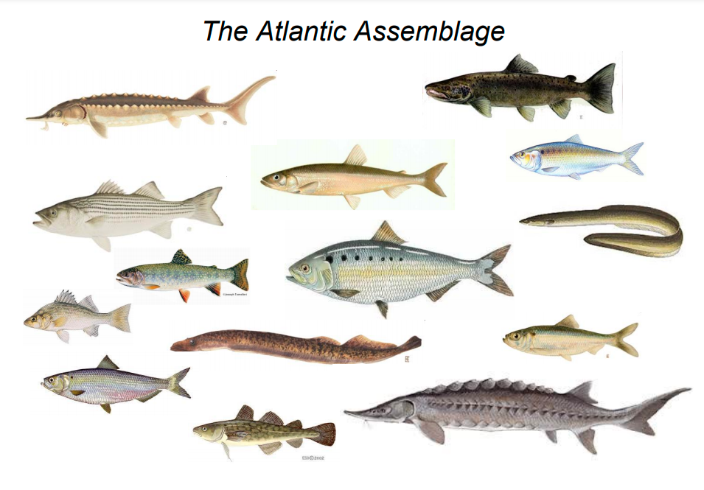
Anadromous fishes of the Atlantic Seaboard
(i.e. the ones who have to swim up freshwater tributaries)
From John Waldman HRF presentation

Slide 29
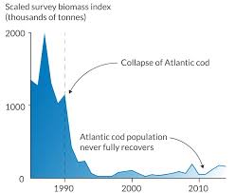
Many commercially important ocean fisheries have been impacted by the loss of
anadromous forage fish like alewife. One example is the cod.
Note: The cod collapse is thought to be due to the combination of overfishing and loss
of spawning habitat of alewife and blueback herring in freshwater tributaries.

Slide 30

What makes a hydroelectric plant LOW IMPACT?
The LIHI is nonprofit that certifies hydropower facilities to be Low Impact
if they conform to specific environmental criteria.
  Ecological flow regimes that support healthy habitats
  Water quality supportive of fish & wildlife resources and human uses
  Safe, timely & effective upstream and downstream fish passage
  Protection, mitigation & enhancement of the soils, vegetation, & ecosystem functions in the watershed
  Protection of threatened and endangered species
  Avoidance of impacts on cultural and historic resources
  Recreation access is provided without fee or charge

Slide 31
What makes a hydroelectric plant LOW IMPACT?
The LIHI is nonprofit that certifies hydropower facilities to be Low Impact
if they conform to specific environmental criteria.
  Ecological flow regimes that support healthy habitats
  Water quality supportive of fish & wildlife resources and human uses
  Safe, timely & effective upstream and downstream fish passage
  Protection, mitigation & enhancement of the soils, vegetation, & ecosystem functions in the watershed
  Protection of threatened and endangered species
  Avoidance of impacts on cultural and historic resources
  Recreation access is provided without fee or charge
NOTE the breadth and depth of parameters that must be met to certify!
Go to https://lowimpacthydro.org/ for more information on the LIHI program

Slide 32
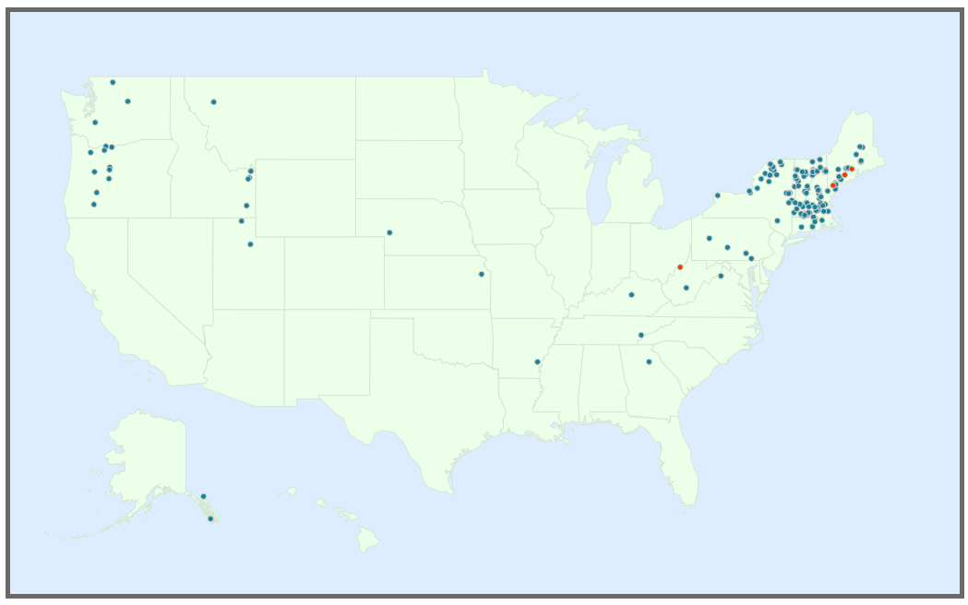
The LIHI has 164 currently certified Low Impact Hydroelectric facilities
Go to https://lowimpacthydro.org/ for more information on the LIHI program

Slide 33
Spectrum of impact for different hydroelectric designs
(rough guide based on fish passage consideration only, just to illustrate that impact is a continuum.)
Low Impact
Hydroelectric
High Impact
Hydroelectric
Closed loop pumped
storage
NO DAM. run- of- river.
DAM w.
Nature-Like
bypass
DAM w.
Fish ladder
(dam located far upstream from the Long Island Sound. Upstream=lower impact to fish migration)
DAM w.
Fish ladder.
(Dam located far downstream near Pacific ocean.
Downstream=higher impact to migrating fish)
DAM w/o
fish ladder.
Located far upstream
DAM w/o
fish ladder.
Located far downstream

Slide 34
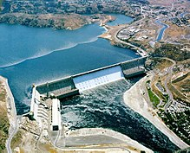
Spectrum of impact for different hydroelectric designs
(rough guide based on fish passage consideration only, just to illustrate that impact is a continuum)
Low Impact
Hydroelectric
High Impact
Hydroelectric
Closed loop pumped
storage
NO DAM. run- of- river.
DAM w.
Nature-Like
bypass
DAM w.
Fish ladder
(dam located far upstream from the Long Island Sound. Upstream=lower impact to fish migration)
DAM w.
Fish ladder.
(Dam located far downstream near Pacific ocean.
Downstream=higher impact to migrating fish)
DAM w/o
fish ladder.
Located far upstream
DAM w/o
fish ladder.
Located far downstream
The Grand Coulee Dam
Columbia River

Slide 35
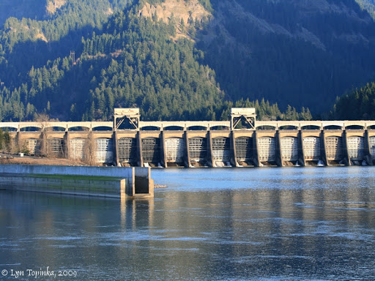
Spectrum of impact for different hydroelectric designs
(rough guide based on fish passage consideration only, just to illustrate that impact is a continuum)
Low Impact
Hydroelectric
High Impact
Hydroelectric
Closed loop pumped
storage
NO DAM. run- of- river.
DAM w.
Nature-Like
bypass
DAM w.
Fish ladder
(dam located far upstream from the Long Island Sound. Upstream=lower impact to fish migration)
DAM w.
Fish ladder.
(Dam located far downstream near Pacific ocean.
Downstream=higher impact to migrating fish)
DAM w/o
fish ladder.
Located far upstream
DAM w/o
fish ladder.
Located far downstream
Bonneville Dam
Columbia River

Slide 36
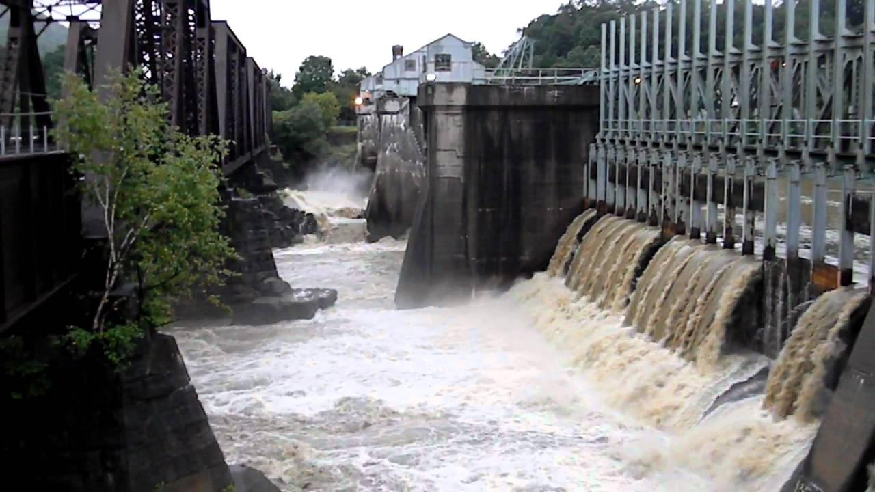
Spectrum of impact for different hydroelectric designs
(rough guide based on fish passage consideration only, just to illustrate that impact is a continuum)
Low Impact
Hydroelectric
High Impact
Hydroelectric
Closed loop pumped
storage
NO DAM. run- of- river.
DAM w.
Nature-Like
bypass
DAM w.
Fish ladder
(dam located far upstream from the Long Island Sound. Upstream=lower impact to fish migration)
DAM w.
Fish ladder.
(Dam located far downstream near Pacific ocean.
Downstream=higher impact to migrating fish)
DAM w/o
fish ladder.
Located far upstream
DAM w/o
fish ladder.
Located far downstream
Bellows Falls Dam
Connecticut River

Slide 37
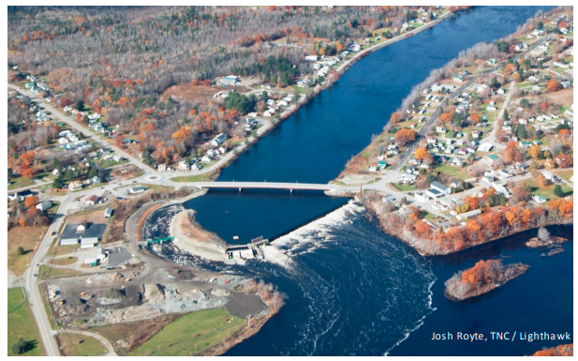
Spectrum of impact for different hydroelectric designs
(rough guide based on fish passage consideration only, just to illustrate that impact is a continuum)
Low Impact
Hydroelectric
High Impact
Hydroelectric
Closed loop pumped
storage
NO DAM. run- of- river.
DAM w.
Nature-Like
bypass
DAM w.
Fish ladder
(dam located far upstream from the Long Island Sound. Upstream=lower impact to fish migration)
DAM w.
Fish ladder.
(Dam located far downstream near Pacific ocean.
Downstream=higher impact to migrating fish)
DAM w/o
fish ladder.
Located far upstream
DAM w/o
fish ladder.
Located far downstream
Howland Dam
Penobscot River, Maine

Slide 38
Hydroelectric dam with fish passable “nature-like” run-of-river bypass
Howland Dam
Penobscot River, Maine

Slide 39
Hydroelectric dam with fish passable “nature-like” run-of-river bypass
Bypass stream
Hydroelectric dam
Howland Dam
Penobscot River, Maine

Slide 40
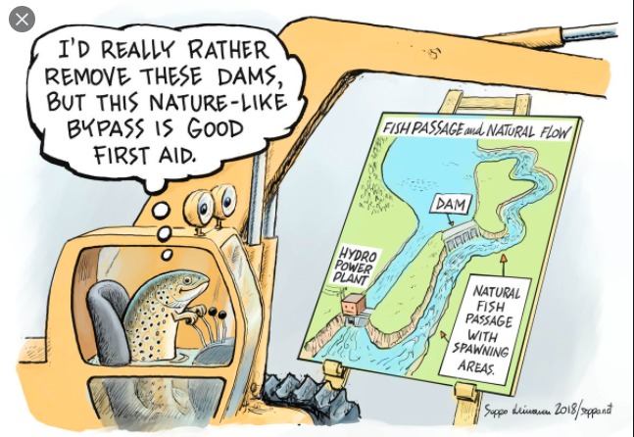

Slide 41
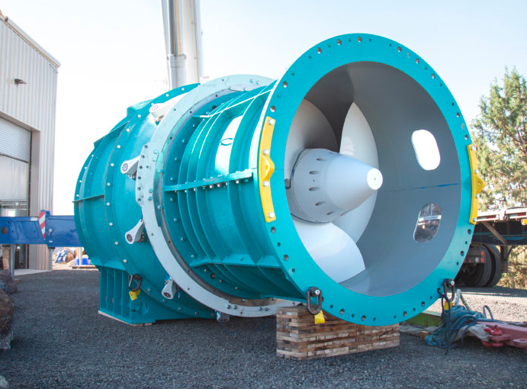
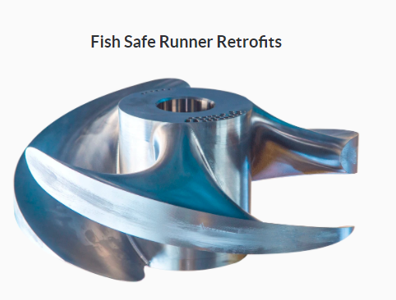
Natel Energy fish-safe Hydroelectric turbine
Low Impact Turbines:

Slide 42
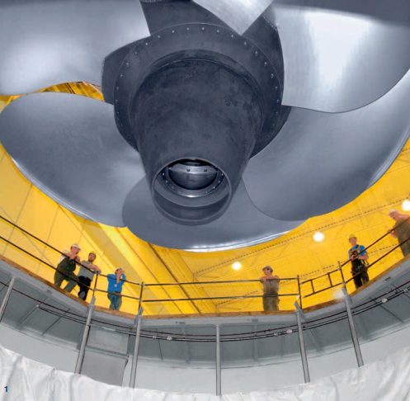
Low Impact Turbines: The Alden Fish Friendly Turbine from Voith.

Slide 43
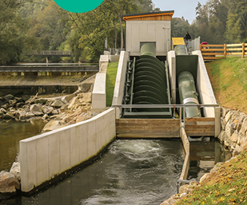
Low Impact Turbines:
Micro hydro Archimedes screw turbine

Slide 44
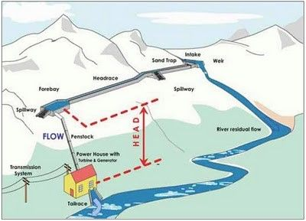
Gradation scale of impact for different hydroelectric designs
Low Impact
Hydroelectric
High Impact
Hydroelectric
Closed loop pumped
storage
NO DAM. run- of- river.
DAM w.
Nature-Like
bypass
DAM w.
Fish ladder
(dam located far upstream from the Long Island Sound. Upstream=lower impact to fish migration)
DAM w.
Fish ladder.
(Dam located far downstream near Pacific ocean.
Downstream=higher impact to migrating fish)
DAM w/o
fish ladder.
Located far upstream
DAM w/o
fish ladder.
Located far downstream

Slide 45
Run-of- River hydroelectric with no dam
(only a small forebay)

Slide 46
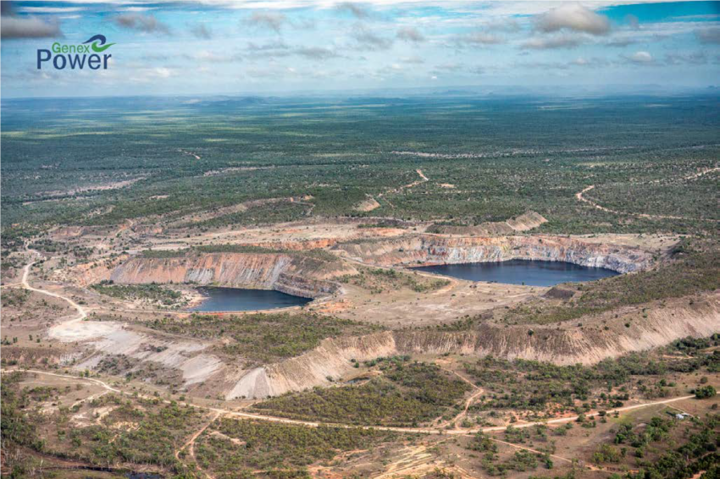
Gradation scale of impact for different hydroelectric designs
Low Impact
Hydroelectric
High Impact
Hydroelectric
Closed loop pumped
storage
NO DAM. run- of- river.
DAM w.
Nature-Like
bypass
DAM w.
Fish ladder
(dam located far upstream from the Long Island Sound. Upstream=lower impact to fish migration)
DAM w.
Fish ladder.
(Dam located far downstream near Pacific ocean.
Downstream=higher impact to migrating fish)
DAM w/o
fish ladder.
Located far upstream
DAM w/o
fish ladder.
Located far downstream
Kidston Closed Loop
Storage, Queensland
Note: The LIHI does not consider closed loop pumped storage to be low impact hydro because
it is energy storage only, not generation. I.e., different category. Should be compared to other storage technologies.

Slide 47
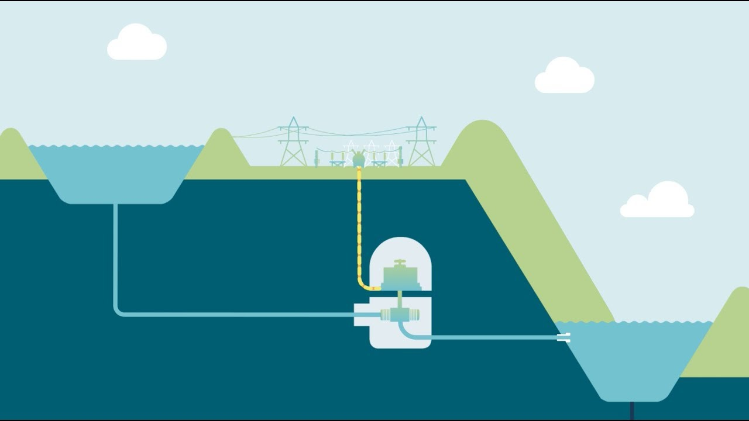
Closed Loop Pumped Storage
High Reservoir
Low Reservoir
During high electricity demand, run the water down through turbines
During low demand, pump water back up to the top.

Slide 48
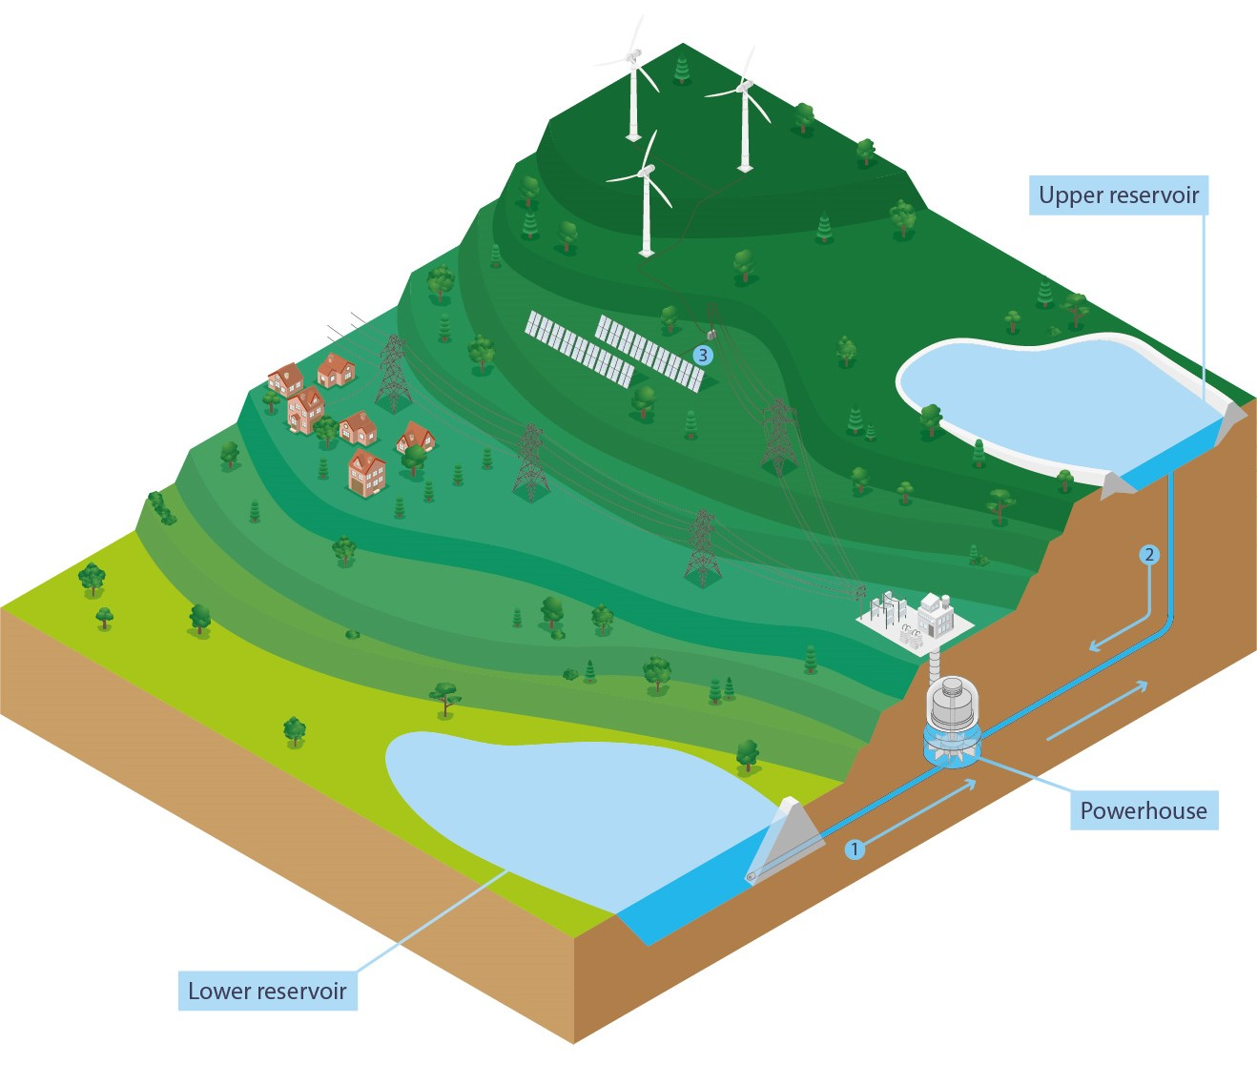

Slide 49
Kidston Closed–Loop Pumped Storage
Queensland

Slide 50
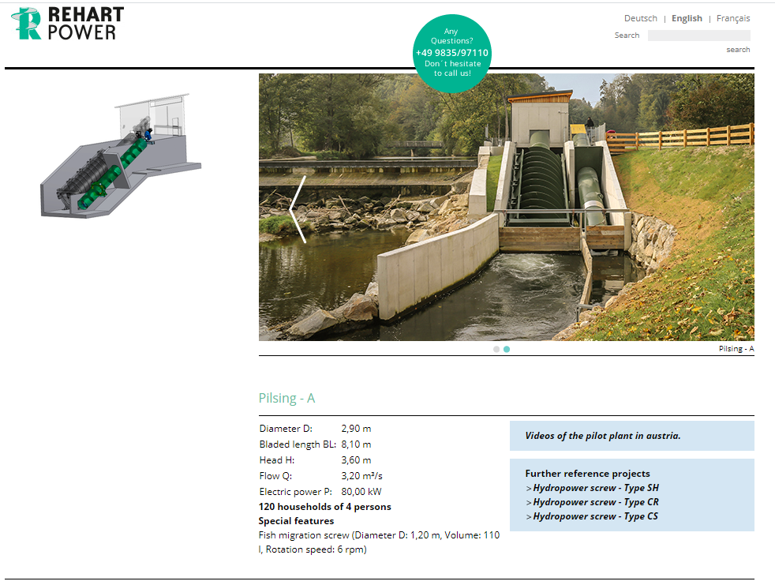

Slide 51
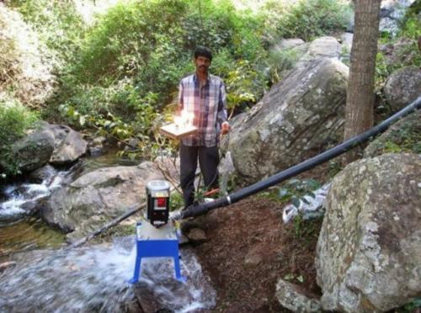

Slide 52
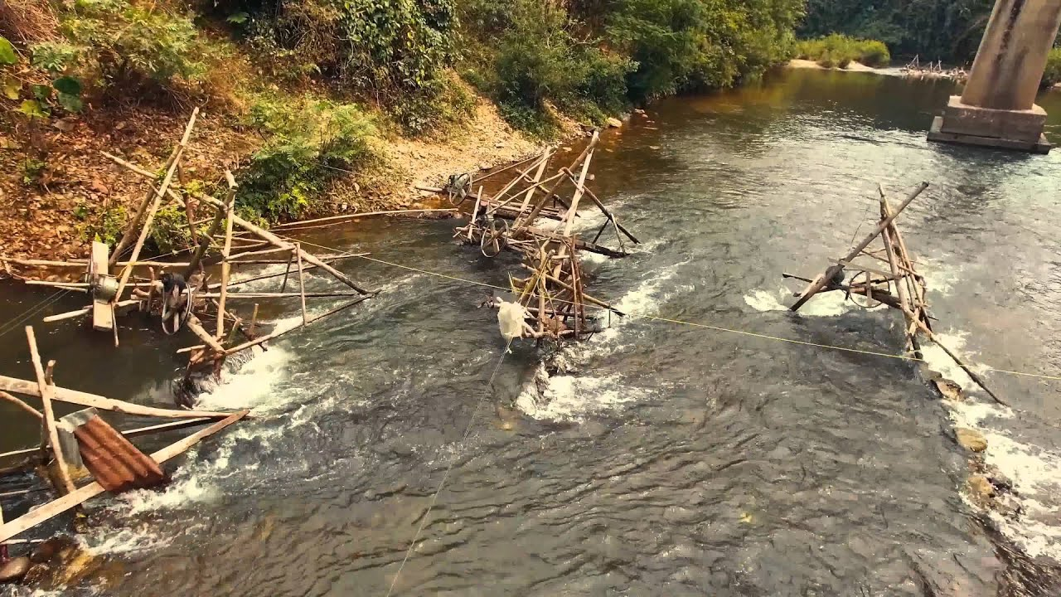
Micro Hydroelectric generation in NW Vietnam village. Set-up involves bamboo and wooden sluices channelling water into oil drums fitted with hand-carved bamboo turbines. Electricity generation was via motorbike alternators. Interestingly, high-tension power lines ran through the middle of the village, but clearly were not used by the villagers. Taken in October 2000 by Shermozle.

Slide 53
Conclusions:
Hydroelectricity is a renewable source of energy that can be important for load balancing
solar and wind that are variable with weather.
However, the dams associated with conventional hydropower have significant environmental impact.
An important example of impact is the blocking of anadromous fish migration for spawning, causing population decline.
In some cases, new technologies and design approaches can mitigate or avoid these impacts.
These are collectively termed Low Impact Hydro (LIH).
Overcoming fish migration issues require that both up AND downstream migration be enabled.
Fish ladders are notoriously inefficient and are often ineffective.
Upstream migration can be enabled via bypass streams where fish can swim past the dam.
Downstream migration can be helped with the use of “fish friendly” turbine design.
Watershed or basin-wide design strategies can greatly improve outcomes for ecological mitigation.
If selectively applied, there are some instances where LIH may be a net benefit for the environment.

